Slide 1



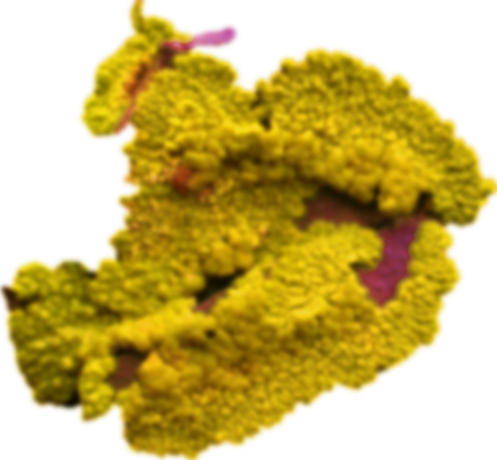
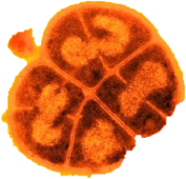
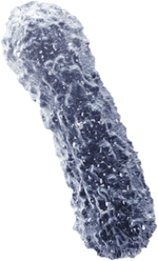
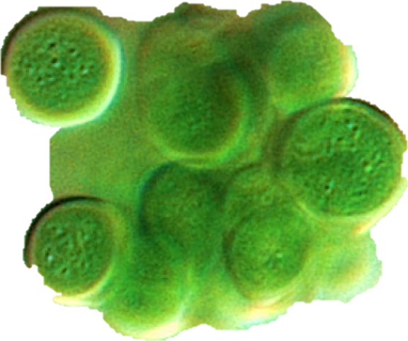




Astronaut micro-organisms
‘‘Colonizing Mars with Matt Damon’’
Gombault Charlotte
Popovic Dorian
Nguyen Duc Jasmine

Slide 2
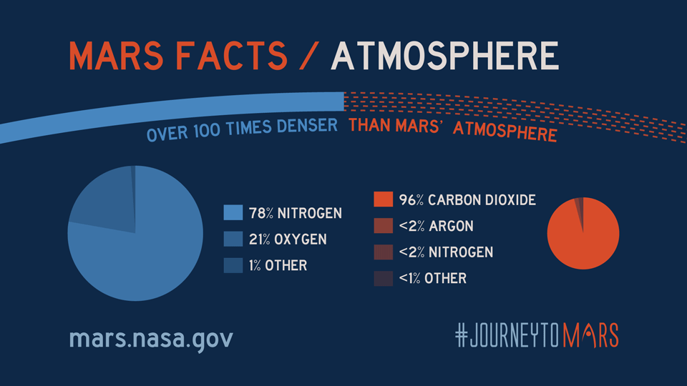
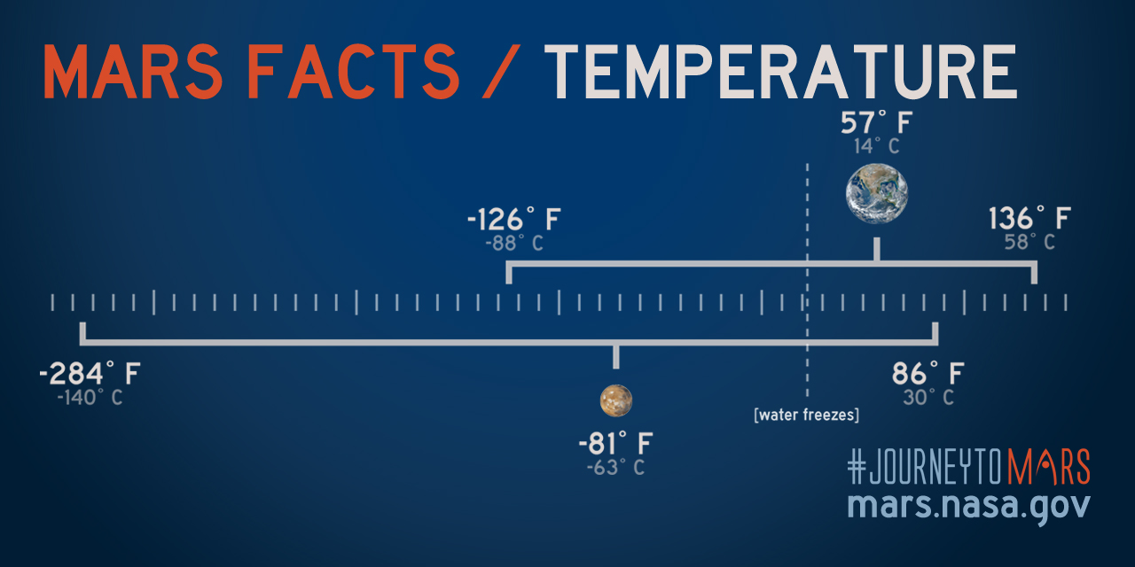
Life conditions on the «red planet»
COMPOSITION
→ Mars atmosphere is extremely thin
→ No presence of water on the surface
PRESSURE
→ Pressure on Mars ranges from 1 to 14 mbar
→ 1000 times less than Earth’s pressure
Cell replication on surface is inhibited!
TEMPERATURE
→ Mars can’t retain heat.
→ On average the temperature there is -60˚C !
RADIATION
→ Radiation on Mars is 2.5 times higher than on the ISS.
→ No protection against radiation
All life would be vulnerable to radiations!
These are the conditions on Mars…
https://marsmobile.jpl.nasa.gov/allaboutmars/facts/#?c=inspace&s=distance
… so how could anything thrive on this planet ??
https://marsmobile.jpl.nasa.gov/allaboutmars/facts/#?c=inspace&s=distance

Slide 3
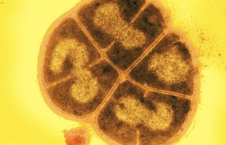

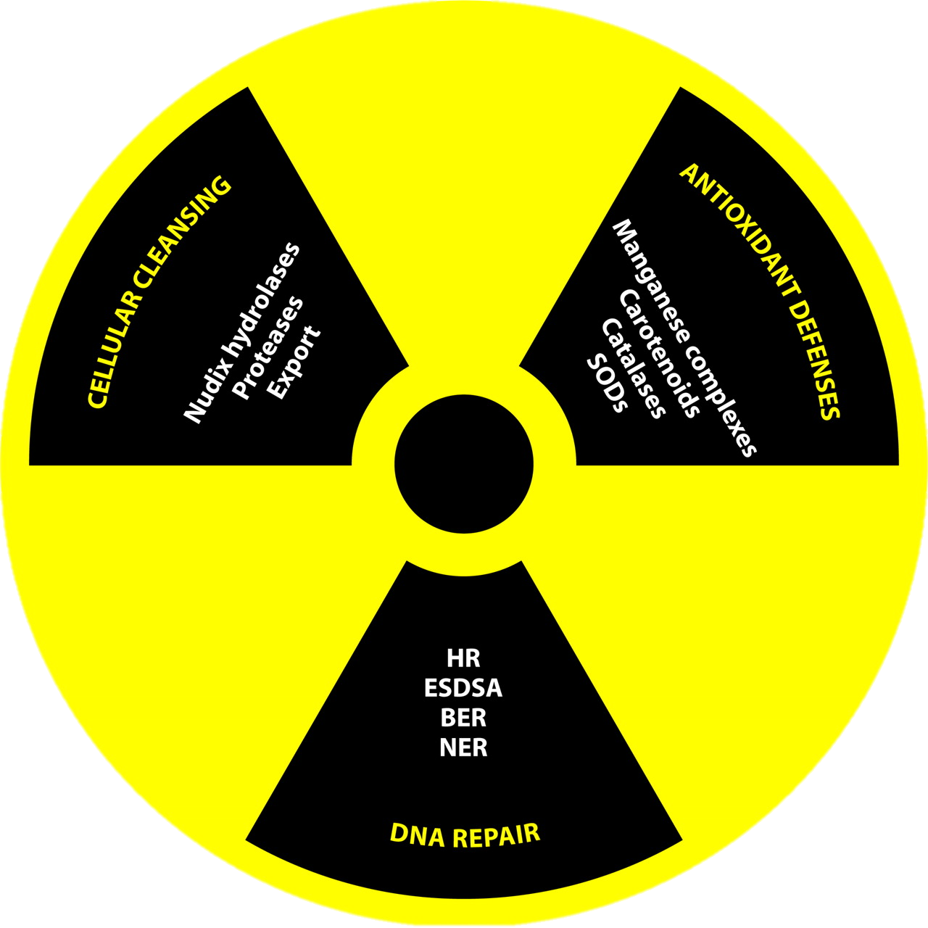
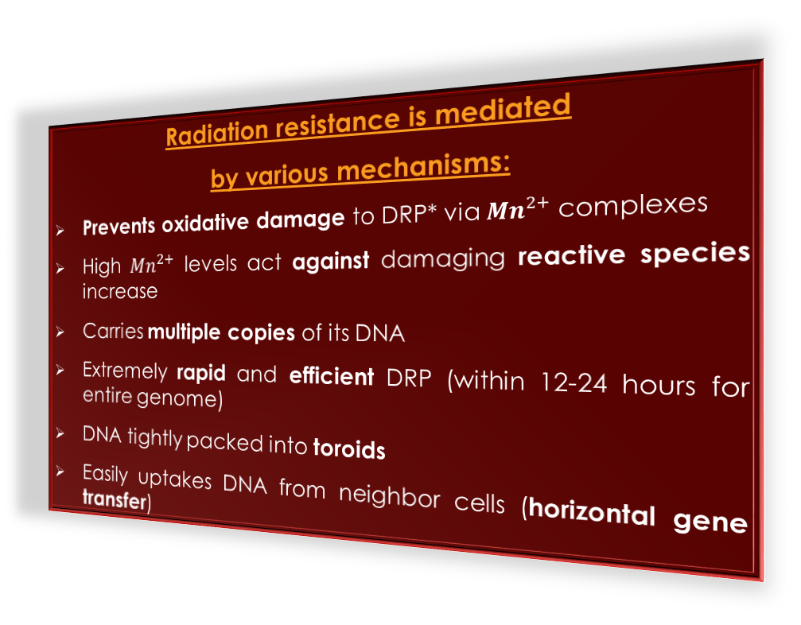
Deinococcus radiodurans - the world’s toughest bacteria
Charactericstics:
Poly-extremophilic bacterium
One of the most radiation-resistant organism known
Can also survive cold, dehydration, vacuum, acid...
(The Guinness Book of World Records: toughest bacterium)
Radiation resistance is mediated
by various mechanisms:
Prevents oxidative damage to DRP* via ${Mn}^{2+}$complexes
High ${Mn}^{2+}$ levels act against damaging reactive species increase
Carries multiple copies of its DNA
Extremely rapid and efficient DRP (within 12-24 hours for entire genome)
DNA tightly packed into toroids
Easily uptakes DNA from neighbor cells (horizontal gene transfer)
https://www.micropia.nl/en/discover/microbiology/deinococcus-radiodurans/
To survive under high radiation, it is more important to protect your proteins rather than your DNA.
Persistance over resistance.
https://www.ncbi.nlm.nih.gov/pmc/articles/PMC3685888/
*DRP: DNA repair protein

Slide 4
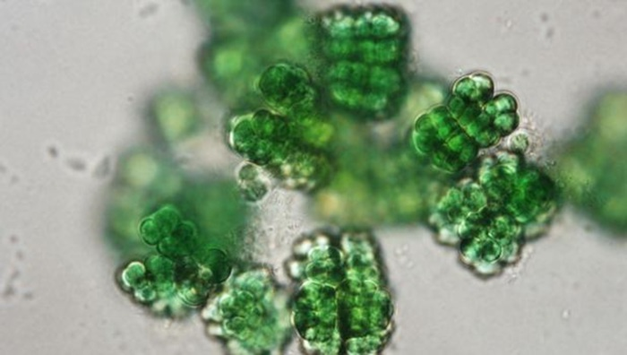
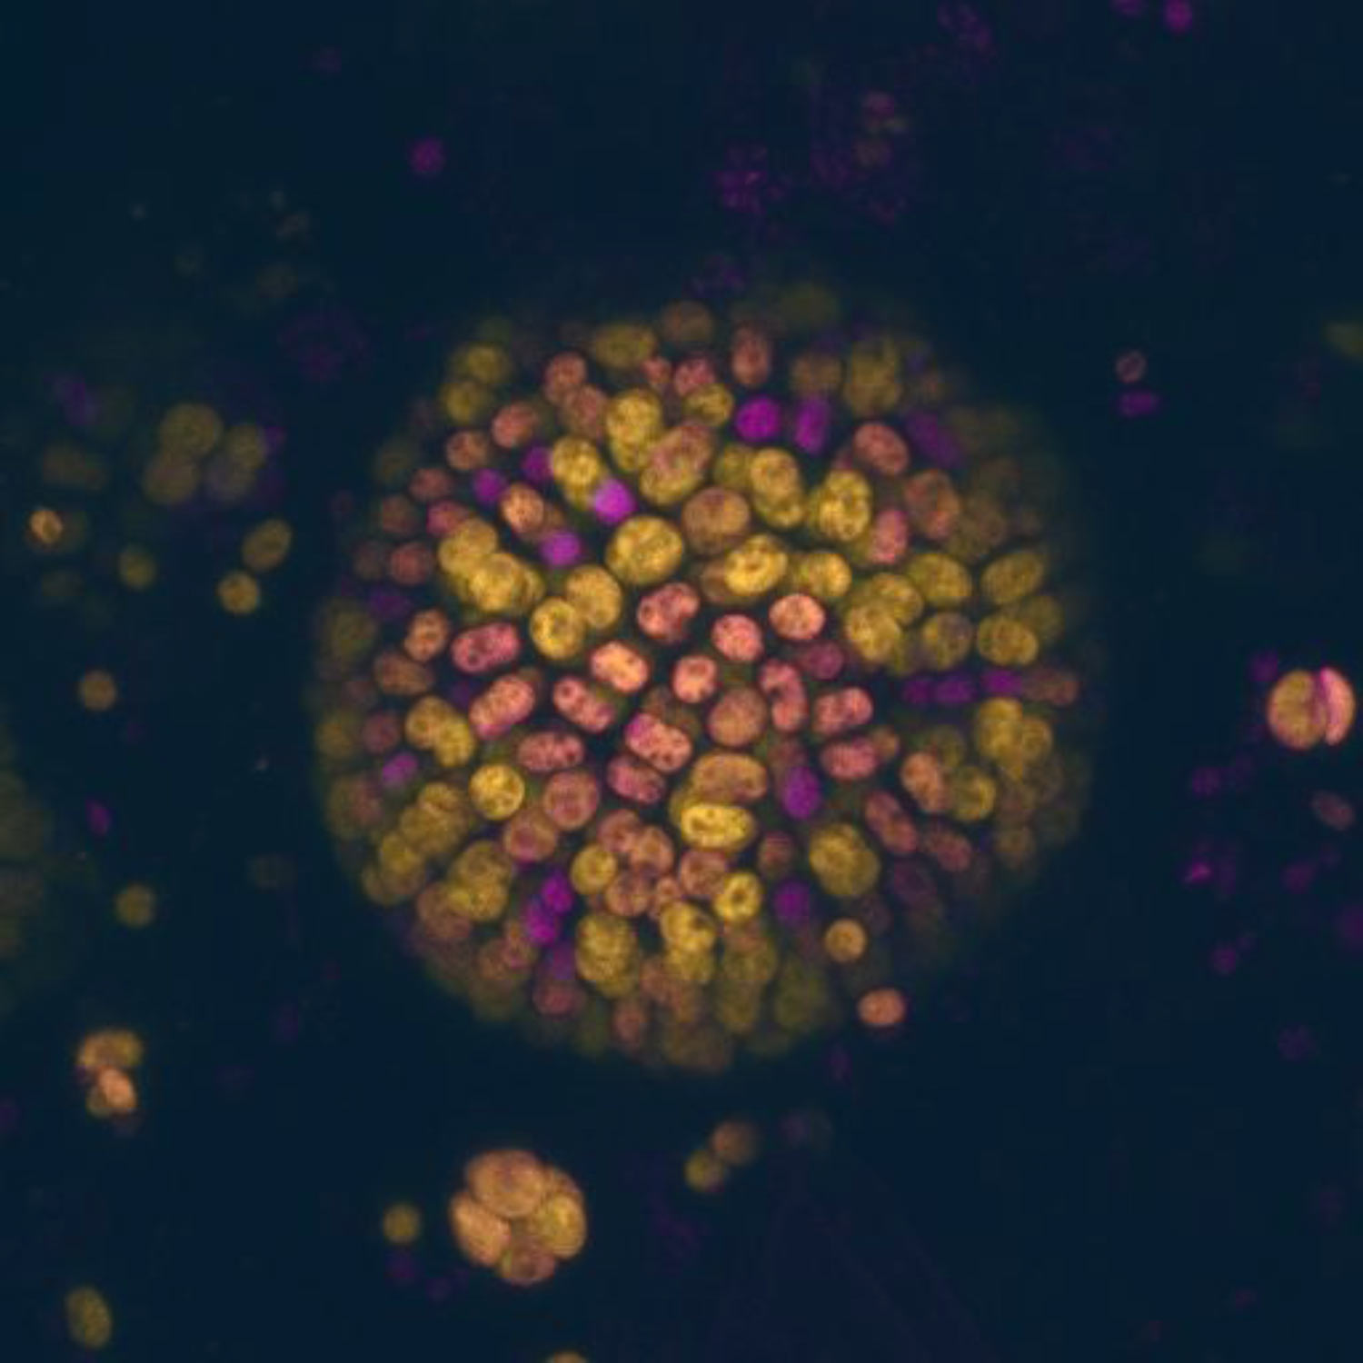
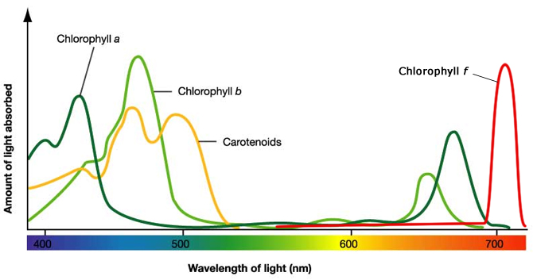
Chroococcidiopsis - tough name, tougher organism
Charactericstics:
Cyanobacteria
Resistant to radiation
Can resist a wide range of temperature
Can survive in places where light access is limited
Performs a unique type of photosynthesis
Photosynthesis with less light:
Performs photosynthesis in a unique way under certain conditions
Uses near-infrared light, up to wavelengths of 750 nm
Lower-energy light to do the chemistry
Chlorophyll-f, special type of chlorophyll
Outside « red-limit » photosynthesis
The picture on the left shows absorption spectra for different types of chlorophyll molecules. On the right are depicted Chroococcidiopsis cells using the 2 different types of chlorophyll molecules ( a magenta, f yellow).
https://www.asdigitalnews.com/l/%C2%BFpuede-esta-bacteria-terraformar-marte/
Harsh conditions
on Mars
Chroococcidiopsis in sub-surface environments
Performs low-energy light driven photosynthesis
Produces oxygen on Mars
Biosphere for humans
Low-light adapted cyanobacteria could be used to colonize Mars and other planets, to produce oxygen and create a biosphere.
https://reefbuilders.com/2010/08/23/chlorophyll-f-a-newly-discovered-photosynthetic-pigment-uses-infrared-light/#
https://scitechdaily.com/scientists-discover-new-type-of-photosynthesis/

Slide 5
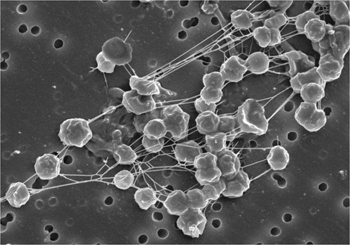
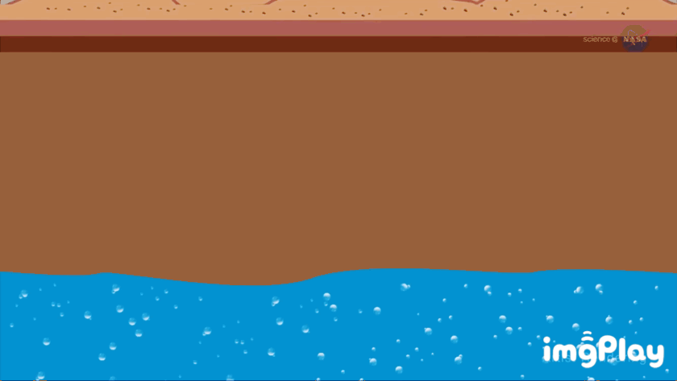
Methanogens – ... Or martians ?
Charactericstics:
Archae
Not photosynthetic
Can thrive in sub-surface environments
Do not require organics
Anaerobic
Tested for their ability to withstand Martian freeze/thaw cycles
Methanogens on Mars
Intriguing presence of methane on Mars
Chemicals reactions should have destroyed it after about 300 years
Suggest that something is still sending the gas into the atmosphere
Could be buried microbes or other forms of life
Methanogens could also explain the seasonal cycles observed in methane concentration
Subsurface environment is a different matter !
Protected from radiation
Higher pressures
Possibly higher temperatures
Methanogens could very well already be present on Mars !
https://www.youtube.com/watch?v=-0K1jkLZiZQ&t=99s

Slide 6
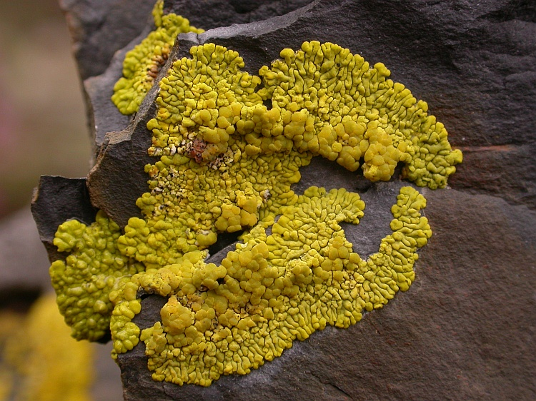
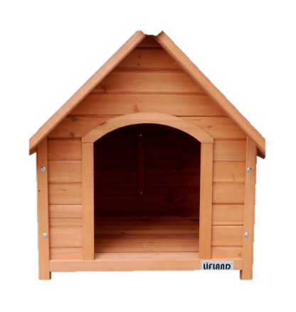
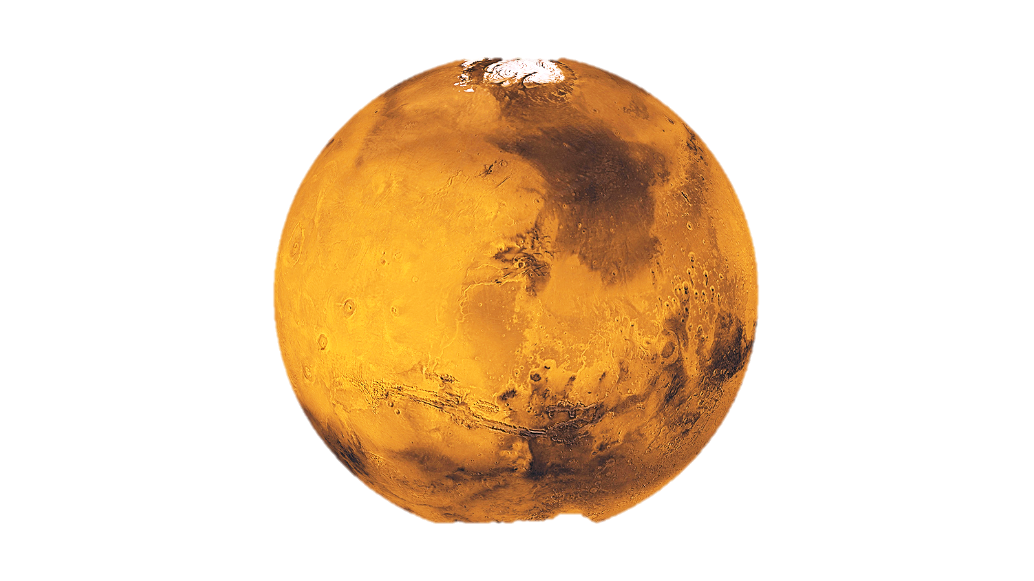
Pleopsidium chlorophanum - our main protagonist
Charactericstics:
Lichen
Resistant to low pressures
Resistant to radiation
Performs photosynthesis
Found in dry arctic or alpine sandstone cliffs and boulders
Can extract water from ice
Martian radiation test
Still able to perform photosynthesis when exposed to 24 times less than full blunt radiation (Mars)
Can survive under temperature as low as - 51˚C
Has been tested in a Martian niche condition… how did it do ?

Slide 7
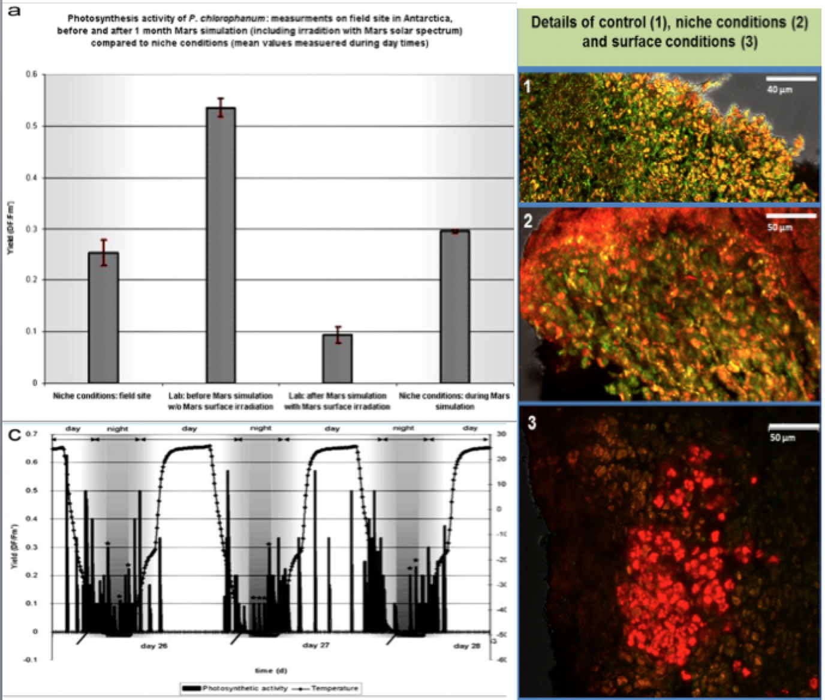

Pleopsidium chlorophanum
Adaptation to martian niche condtion
Initial activity on Mars → stress provokes ineffective transfer of energy to heat
After 34 days → effects decrease as Lichen adapts to niche conditions
FUN1 LIVE/DEAD STAIN: Green - metabolically inactive cells Red - matebolically active cells Unstained - dead cells
→ Metabolic acvtivity = Photosynthetive activity ?
Photosynthesis works best with maximum ligth and low temperatures → sunrise and sunset
Abstract: P.chlorophanum is capable of performing photosynthesis when located in niches that protect it from radiation. A recent research has demonstrated its surviving capabilities under a simulation of Martian conditions.
A
B
A
B
C
C
THIS ONE LOOKS THE MOST PROMISING YET !
https://core.ac.uk/download/pdf/31019036.pdf

Slide 8

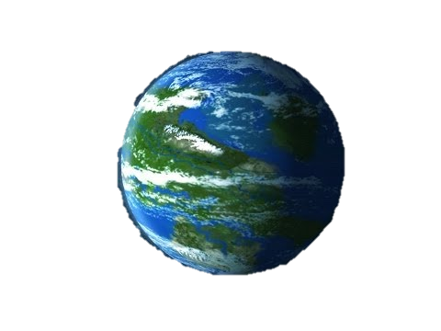
Take home messages
Colonizing Mars with the help of astronaut micro-organisms could part of the near future
Others can teach us how to survive harsh conditions such as those found on Mars
Some may also already be there
And lastly, one has proven its capability to survive under Martian conditions
Sources:
https://www.ncbi.nlm.nih.gov/pubmed/10567266
Paper: “Genome sequence of the radioresistant bacterium Deinococcus radiodurans R1”.
https://www.ncbi.nlm.nih.gov/pmc/articles/PMC3685888/
Paper: “Biology of Extreme Radiation Resistance: The Way of Deinococcus radiodurans”
https://core.ac.uk/download/pdf/31019036.pdf
Paper: ”Adaptation of an Antarctic lichen to Martian niche conditions can occur within 34 days “
References:
https://www.asdigitalnews.com/l/%C2%BFpuede-esta-bacteria-terraformar-marte/
https://astrobiology.nasa.gov/news/microbes-could-survive-thin-air-of-mars/
http://www.astronomy.com/news/2006/10/could-microbes-survive-on-mars
http://www.bbc.com/earth/story/20151221-the-microbes-so-extreme-they-might-survive-on-mars
https://planetsave.com/2012/06/09/microbes-capable-of-surviving-on-mars-found/
https://www.universetoday.com/137820/life-mars-can-survive-millions-years-even-right-near-surface/
https://www.cambridge.org/core/journals/international-journal-of-astrobiology/article/bacterial-growth-tolerance-to-concentrations-of-chlorate-and-perchlorate-salts-relevant-to-mars/35D9C3011983169B61A084C931FD4D2D
http://www.bbc.com/earth/story/20150313-the-toughest-animals-on-earth
https://www.scientificamerican.com/article/bacteria-discovered-spacecraft-clean-rooms/
https://www.nasa.gov/mission_pages/station/research/experiments/92.html
https://www.digitaltrends.com/cool-tech/bacteria-help-terraform-mars/
https://www.popularmechanics.com/space/moon-mars/a15410/terraform-mars-with-microbes/

